Slide 1
Water & Pollution Control
Fats, Oils, and Grease Control Program
www.cityofames.org/FOG
Dustin Albrecht, Environmental Specialist

Slide 2
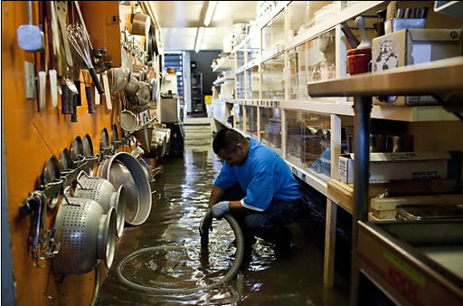
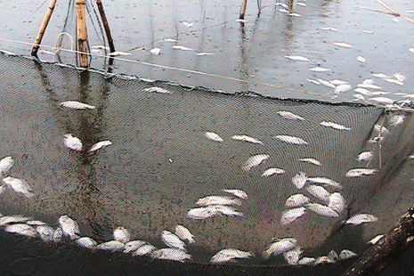
What are the reasons for having the FOG Control Program?
Public Health
Environmental Concerns
Financial

Slide 3
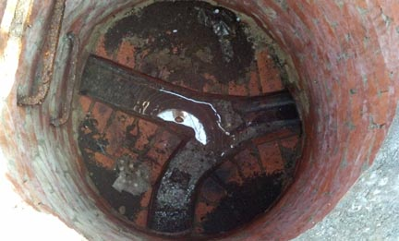
No accumulation of FOG
Free flowing wastewater

Slide 4
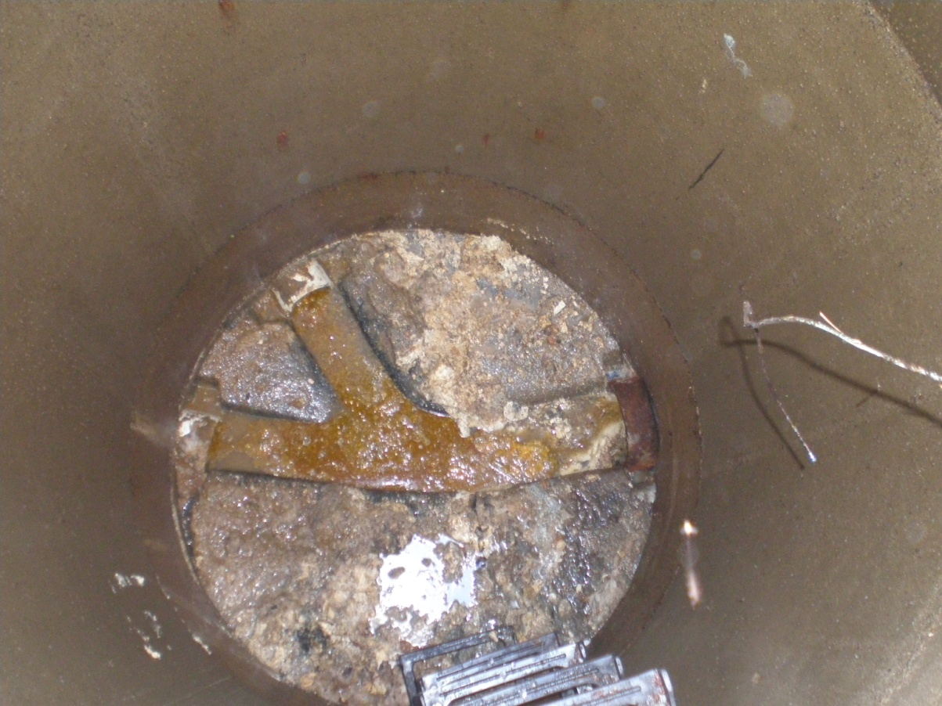
Accumulation of FOG
Obstruction of flow
Non-compliant FSEs

Slide 5
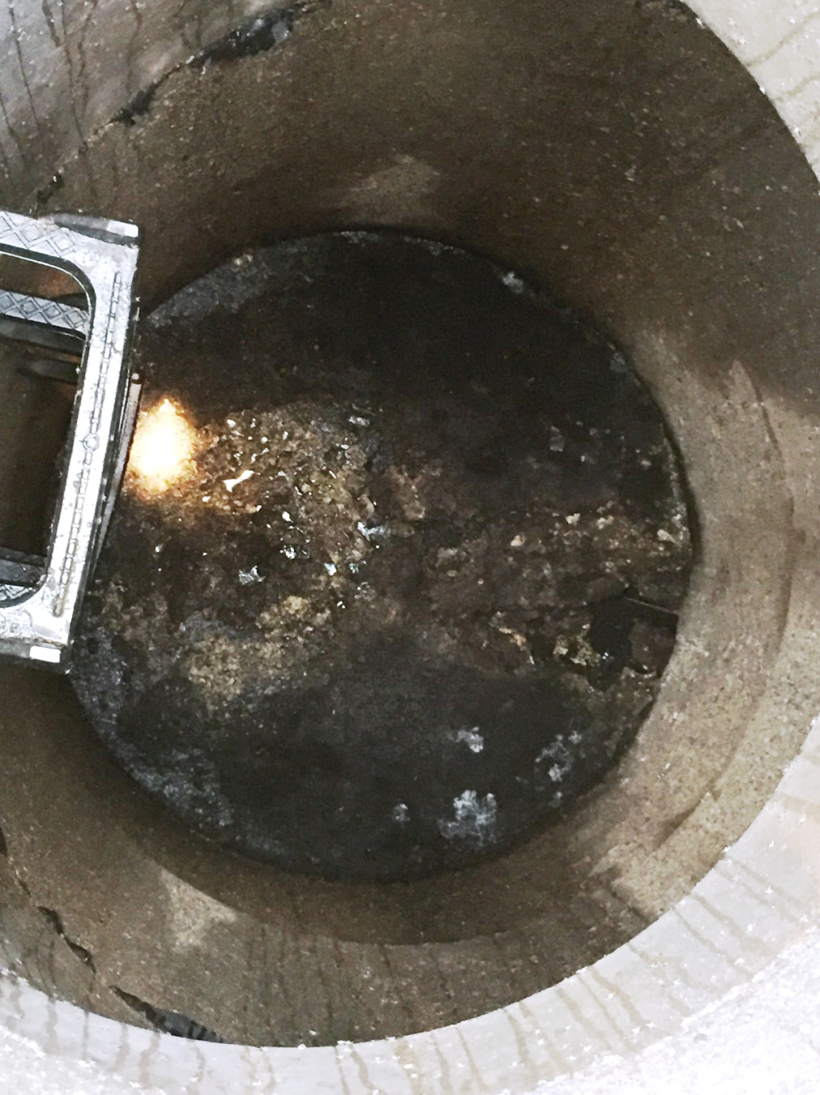
Large amounts of FOG
Chronic issue
Cleanup is necessary
Penalties
Cost of cleanup ($800 - $1,200)
Fine up to $1,000

Slide 6
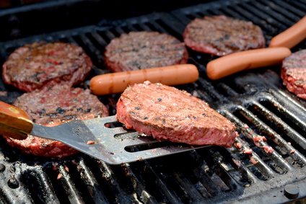
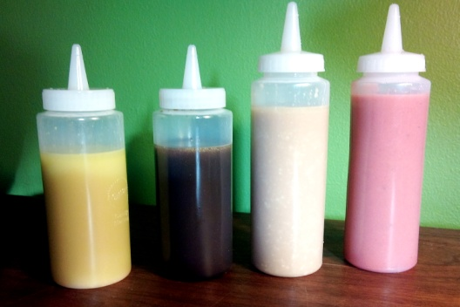
Sources of FOG
Fryer oil, grease/fat from meat, milk, butter, margarine, eggs, lard, salad dressing, creamer, sauces, gravies, ice cream, mayonnaise, syrups, cake icing, sour cream, peanut butter, chocolate, food scraps…

Slide 7
Why is my business/facility on the FOG Control Program?
License with DIA
Connected to City of Ames sanitary sewer
Four types of licenses issued by DIA
Food Service Establishment
Retail Food Establishment
Mobile Food Unit
Food Processing Plant

Slide 8
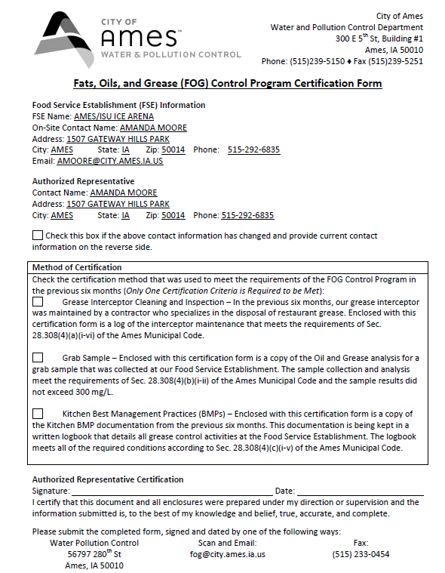

Slide 11
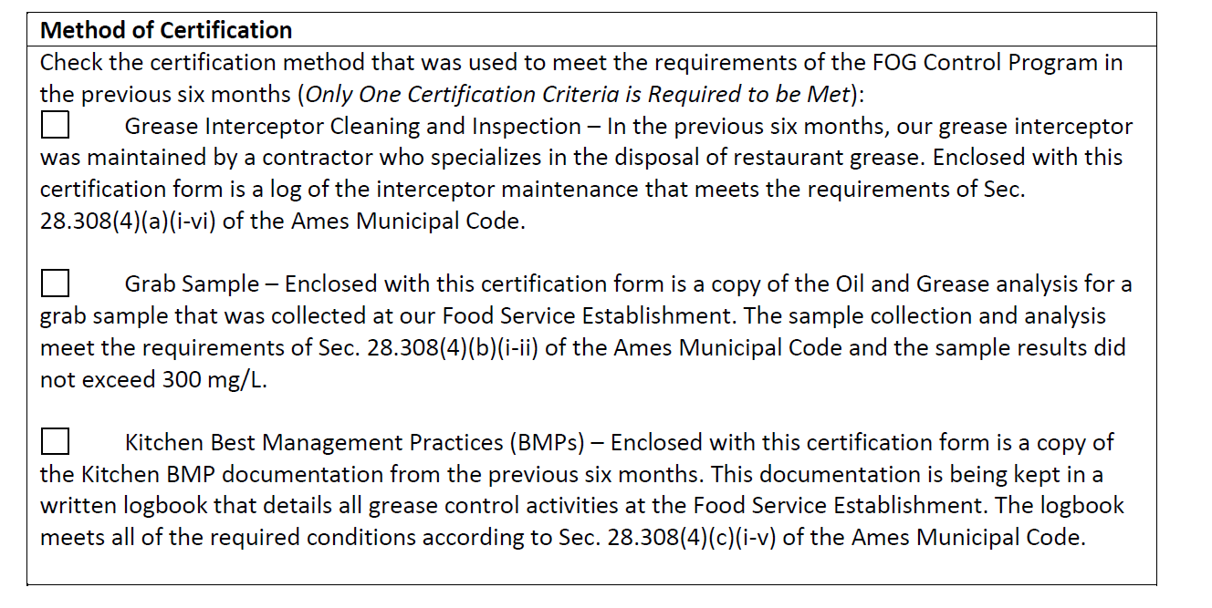
Grease Interceptor Cleaning/Inspection

Slide 12
Basic Grease Interceptor Operation
FOG
Water
Solids
• Solids settle to the bottom • FOG floats to the top

Slide 13
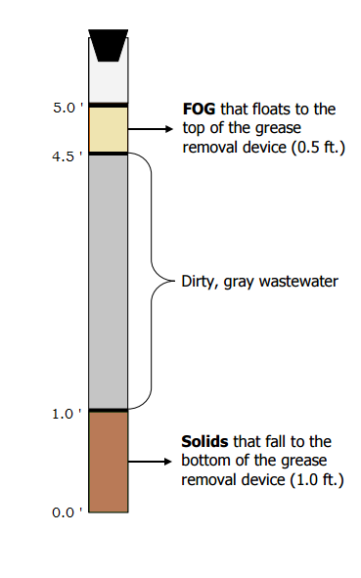
How full is too full?
Ames Municipal Code
No more than 35% at any cleaning
Average for all cleanings during compliance period must be 25% or less
Example
% Full = (Fog (ft) + Solids (ft)) / Total Depth (ft)
= ( 0.5 + 1.0 ) / 5.0
= 1.5 / 5.0
= 30%
Too Full

Slide 14
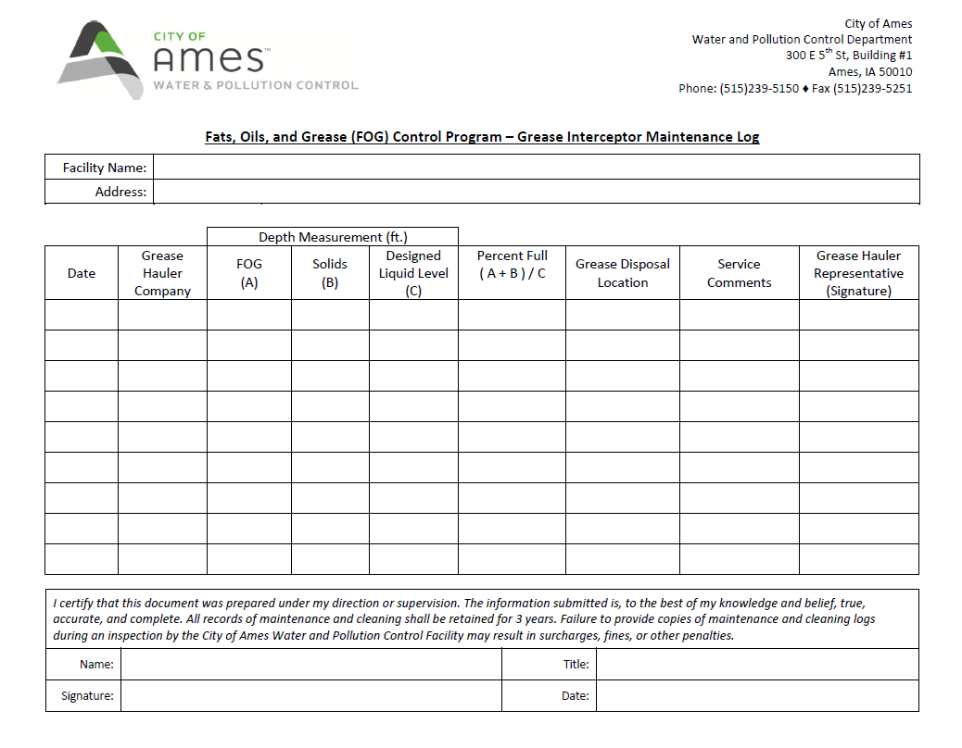
Filling out the Maintenance Logs
Ames/ISU Ice Arena
1507 Gateway Hills Park
8/6/15
Acme
0.5
1.0
5.0
30%
AMES WPC
None
Amanda Moore
Recreation Coordinator
1/5/2016

Slide 15
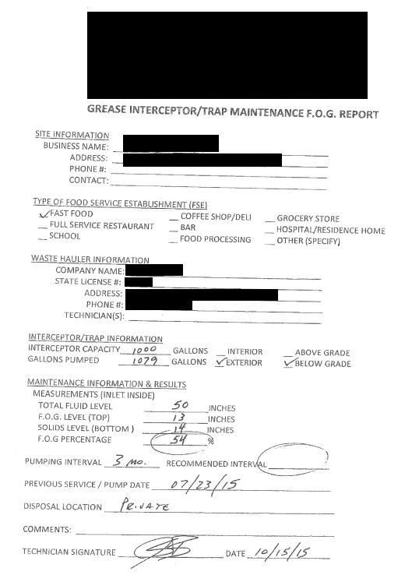
Another Example
Date
• Name of FSE
• Hauler Company & Employee
• Percentage Full
• Disposal Location
• Service Comments

Slide 16
Common errors/problems
No records/logs
Not including all records
Information missing
High percentages
Disposal location
Cannot include too much information

Slide 17
Grab Sample
Time and date of sample is determined by City of Ames W&PC staff.

Slide 18
Kitchen Best Management Practices

Slide 19
Kitchen Best Management Practices (BMPs)
Train staff
Scrape/Dry wipe dishes
Use strainers in sinks
Dispose of food waste in trash/recycle
Do not pour oil/grease down drains or toilets
Limit use of garbage disposals
Post ‘No FOG’ signs

Slide 20
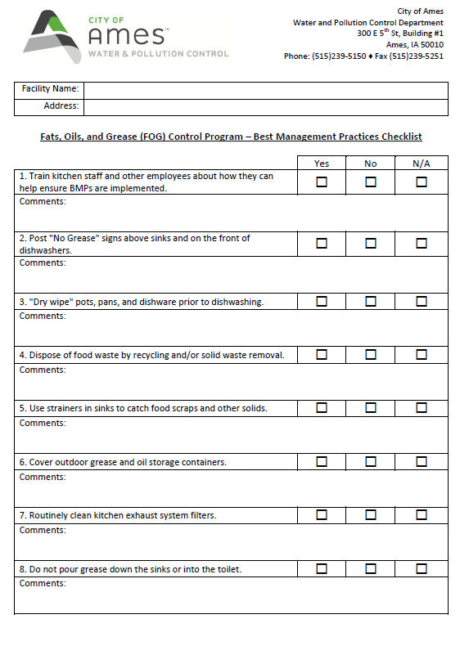
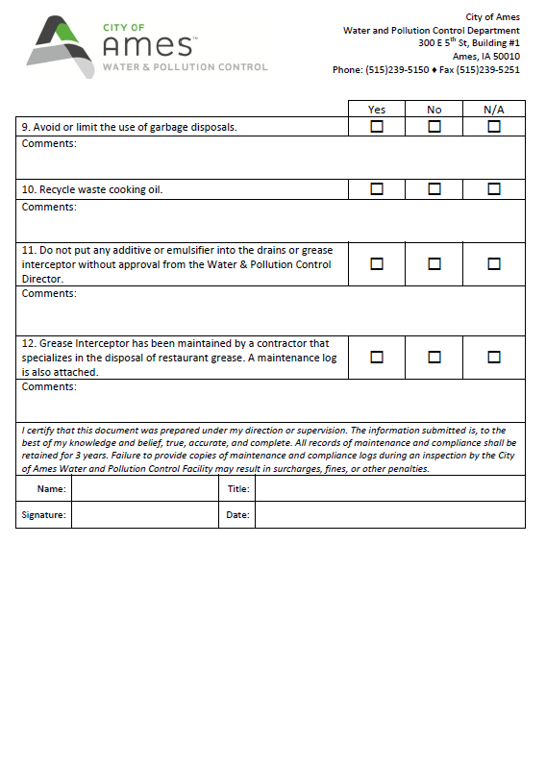
Kitchen BMP Checklist

Slide 21
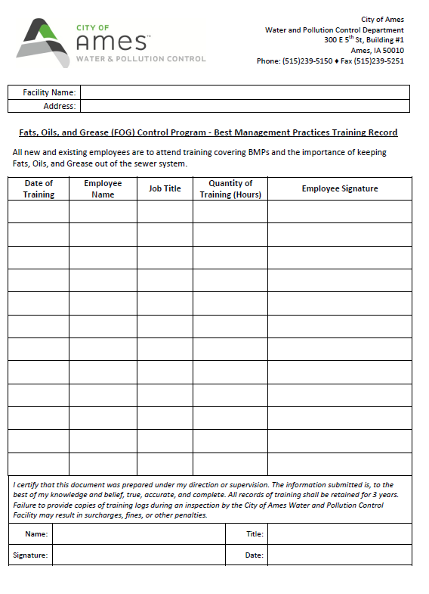
Staff Training Log

Slide 23
Cost of Non-Compliance
Cost of clearing blockages
$800 - $1,200
Fine up to $1,000
Surcharge
Added to utility bill for 6 months
Currently $0.00/100 cubic feet
Collecting data to determine a fair rate

Slide 24
Timeline of Program
Two Compliance Periods/year
January 1 – June 30
July 1 – December 31
City staff developing Restaurant Rate in coming months
Notification of Restaurant Rate in June
Restaurant Rate added to January 2017 usage

Slide 25
Grease Hauler Contractors
A-1 Complete | (515) 265-3986
All Clean of Iowa | (515) 334-0670
Anderson Plumbing | (641) 792-5317
Behle, Inc. | (515) 598-5279
Best Portable Toilets | (515) 453-2211
Earl’s Sanitation | (515) 434-2669
Darpro Solutions, LLC | (515) 265-0381
Davis Septic Tank Service | (515) 202-9596
Draintech | (515) 233-3700
Forest Septic | (515) 208-5022
Gudmonson Service | (515) 576-4991
Hydro-Klean | (515) 283-0500
Jim’s Johns | (515) 288-0924
River to River Onsite Septic Solutions | (515) 987-3913
Roto Rooter | (515) 292-9277
Seneca Waste Solutions | (515) 240-2137
Sweet Honey, Inc. | (515) 402-0094
Wiegert Disposal | (641) 764-2389
This list does not include all grease haulers and in no way implies certification or constitutes acceptance of the work of the listed companies. The City of Ames shall not be responsible for the service provided by any companies on this list.

Slide 26
Dustin Albrecht, Environmental Specialist
Phone: (515) 239-5150
E-Mail: dalbrecht@cityofames.org
FOG Website: http://www.cityofames.org/FOG

